Slide 1
INSURANCE ANALYSIS
PROJECT:

Slide 2
Reports By:
Group 3:-
Sravani Gudla
Ashish Kothari
Ankita Laha
Himanshu Anant Tembhurkar
OM JADHALKAR
SAGRIKA

Slide 3
INTRODUCTION

Slide 4
INTRODUCTION :
The aim of this dashboard is to discuss the performance of Business with Ahmedabad Branch by considering cross sell, New and Renewal.
Facilitated seamless communication & decision-making between the insurance
Team and branch heads through the implementation of an innovative Analytics
Dashboard. Collated & Analyzed data from various sources, including invoice sheet,
Brokerage & fees sheets, individual budget sheets , meeting and opportunity records.

Slide 5
SCOPE

Slide 6
SCOPE :
The scope of this analysis is to achieve the No. of invoice by Account executive , yearly meeting Count , Stage funnel by revenue , No. of meetings by Account executive , Top open Opportunity and calculate cross sell , new and renewal. By these KPI’s we can conclude the crucial insights into the performance of account executives & Showcases the no. of meetings , opportunities & revenue targets.

Slide 7
OBJECTIVE

Slide 8
OBJECTIVE :
No. of in voice by account executive
Yearly meeting count
Cross sell -- TARGET,ACHIVE,NEW
NEW -- TARGET,ACHIVE,NEW
RENEWAL -- TARGET,ACHIVE,NEW
STAGE FUNNEL BY REVENUE
NO.OF MEETINGS BY ACCOUNT EXECUTIVE
TOP OPEN OPPORITUNITY

Slide 9
CROSS SELL:
Cross selling refers to the practice of selling additional insurance policilies to an existing customer.
RENEWAL:
Renewal refers to the process of extending an existing insurance policy.
New:
New business refers to the process of selling insurance policies to new customers.

Slide 10
GENERAL OVERIVEW

Slide 11
OPEN OPPURTUNITY
COUNT
44
OPPORTUNITY ID COUNT
49

Slide 12
CROSS SELL % INOVICE ACHVMNT
14.21%
CROSS SELL PLACED ACHVMNT %
62.96%
NEW % INVOICE ACHVMNT
2.90%
NEW PLACED ACHVMNT %
17.44%
RENEWAL % INOVICE ACHVMNT
66.92%
CROSS SELL % INOVICE ACHVMNT
150.08%

Slide 13
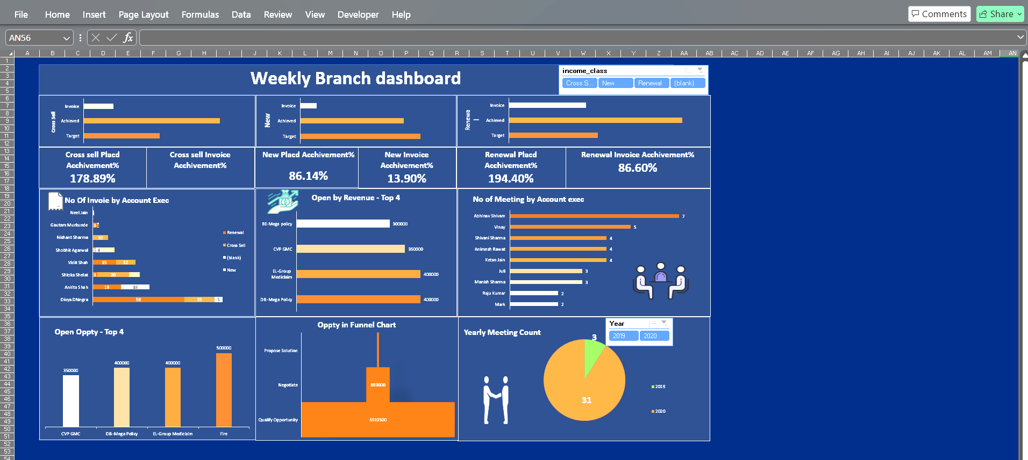
EXCEL DASHBOARD :
The Excel-based dashboard provides a comprehensive view of the insurance company's performance across various metrics, enabling data-driven decision making. This dashboard helps to track the cross sell , new business and renewals.

Slide 14
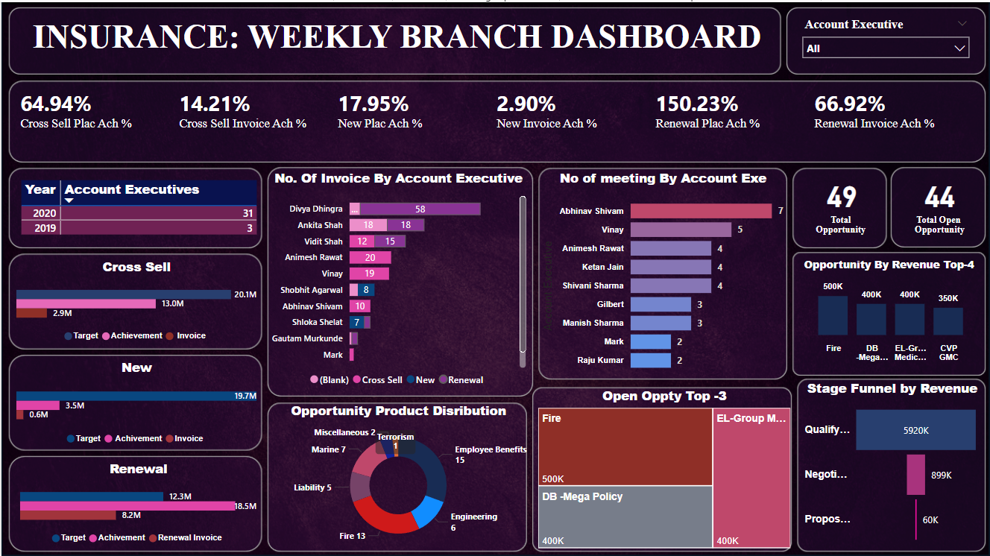
POWER BI DASHBOARD :
The Power BI dashboard integrates multiple data sources and provides a centralized view of the insurance company's performance, enabling efficient monitoring and reporting.

Slide 15
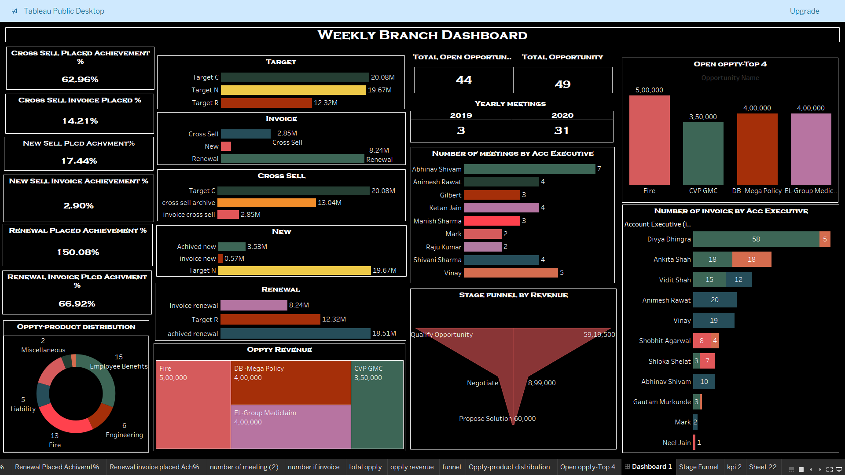
TABLEAU DASHBOARD :
This dashboard highlighted on key kpi’s such as cross sell achievement , new business, renewal performance & invoicing. It served aa a critical tool for discussions between corporate teams and branch heads, driving strategic decision – making .

Slide 16
INSIGHTS

Slide 17
INSIGHTS :
The cross sell achievement rate is highest in the renewal category, indicating a strong focus on retaining existing customers. It refers the opportunity sheet .
Account executives with higher meeting counts generally show better performance in invoicing, suggesting the importance of client engagement.
The stage funnel shows a significant drop-off from qualification to proposal, indicating room for improvement in closing deals.
Product distribution is dominated by employee benefits and fire categories, highlighting the need to diversify the insurance portfolio.

Slide 18
By the kpi 1 Divya Dhingra leads with the Renewal count of 58 and the Neel jain is having least count of new with the value 1.
Second kpi is yearly meeting count , by this we can conclude a notable terms raise in the meeting count .
Stage funnel by revenue aims to the stage of qualify opportunity , there is a more revenue amount with the value of 59.19M.
In the no. of meeting by Acc executive , we can conclude Abhinav Shivam has the highest meeting count with the value of 7 . Mark & Raj kumar has the lowest meeting count with the value of 2.

Slide 19
Cross sell --
Cross sell target is 20.08 M , Cross sell Achieve is 13.04 M , Cross sell Invoice is 2.85 M.
NEW BUSINESS --
New target is 19.67 M , New Achieve is 3.53 M , New Invoice is 0.57 M.
ReNEWAL --
Renewal target is 12.32 M , Renewal Achieve is 18.51M , Renewal Invoice is 8.24 M.

Slide 20
Yearly meeting count raises from 2019 to 2020 .
In 2019 the yearly meeting count is 3.
In 2020 the yearly meeting count is 31.
Hence , we can conclude that a much raise in productivity trends from 2019 to 2020.

Slide 21

THANK YOU
We appreciate your time and look forward to discussing how these insights can drive continued growth and success for the insurance business.

